Slide 1

Foundations of Entrepreneurship
INTRODUCTION TO FINANCIAL STATEMENTS
Manoj K Mondal
RMSoEE, IIT Kharagpur
Lecture Note # 6
20.01.2021
This Photo by Unknown author is licensed under CC BY-NC.

Slide 2
Topics to be covered
Understanding financial statements
Balance sheet
Profit & Loss Account
Cash Flow Statement

Slide 3
How Important is Financial Statements
There is a saying:
If one can’t manage finances, won’t be able to manage a business.
The fact that a major cause of startup failure is ‘running out of cash’, reinforces the above statement.
All entrepreneurs and non-entrepreneurs who are directly or remotely connected to the past, present, and future financials of a company must have a grip on financial statements.
01
03
04

Slide 4
The primary purpose of financial statements is to report the actual financial state of any company to all stakeholders.
Stakeholders
Founders/ Promoters / Owners
Shareholders
Lenders (bankers)
Government (Income tax and GST department)
Economists
Analysts
Investors
Employees
Policymakers or Statisticians

Slide 5
Financial statements should be viewed from two perspectives: one from the entrepreneurs, and the other, from the other stakeholders’ perspectives.
Depending on which side you are in, you would like to look at it through different prisms.
Owners of a company frequently under-report or over-report performance to derive values.
The consumers of the data in financial statements are the victims of such wrong reporting.

Slide 6
From Owners’ Perspective
Decisions
Cost cutting
Pricing
Hiring
Hiving off
Capacity augmentation
Making-vs.- outsourcing
Borrowing
Capital raising

Slide 7
Major Disaster for Accounting Frauds: Enron
At its peak, Enron was one of America’s largest corporations with 22,000 employees.
Reported $111 billion revenues in 2000
Overstated profit and hide debt.
When it came to light,
Share price went from $90.75 in August 2000 to just $0.67 in 2002 to 0.0 soon.

Slide 8


Major Disaster for Accounting Frauds: WorldCom
WorldCom, USA
Was the second biggest phone company
WorldCom fraudulently underreported cost of a staggering $3.8 billion (£3bn).
In 2020, it filed for bankruptcy.
Satyam Computers of Hyderabad
The chairman of Satyam Computers, Ramalinga Raju confessed that the company’s accounts had been falsified to the extent of Rs 12,318 crore.
The company went through turmoil rendering thousand of employees jobless and millions of investor poorer.

Slide 9
Operating cycle starts from cash and moves through purchase of raw materials, converting them into finished goods, selling them and receiving the cash.
In numeric term, the operating cycle is the average period of time required for a business to complete this process.
Cash
Buy raw-materials, pay for salary, utilities, and overhead
Make finished goods
Sell finished goods
Collect money
Accounts receivable
Cash is the king
Cash comes out of cash-flow. Is the inflow greater than the outflow!

Slide 10








Money blocked at different stages of the operating cycle and the importance of managing creditors
Investment in fixed assets | 10,000
Raw-materials stock | 1,000
Goods-in-process | 500
Finished goods | 2,000
Receivables | 2,500
Total for operating cycle | 6,000
Subtotal | 16,000
Investors
Bank
Total: 1,000
Own moneny:600
Borrowing: 400
Goods-in-process | 500
Customers
Finished goods | 2,000
Dealer/Distributor
Receivables | 2,500
Adani Enterprises:

Slide 11
Adani enterprise : has
Receivable cycle of 89.55 days and
Payable cycle of 117.66 days.
Define receivable cycle:
Average outstanding in Receivable: 2,500
Annual sales: 10,000
Receivable turnover ratio: 10,000/2,500 = 4
Receivable cycle: 365/4 = 91.25 days

Slide 12
Money blocked at different stages of the operating cycle and the importance of managing creditors
Investors
Bank
Make payment in 117.66 days
Receive payment in 89.5 days
Distributors
Adani Enterprises:
Annual Sales ₹40,378 crore

Slide 13
Double entry system
Double entry system of accounting means that every business transaction involves two or more accounts.
Example: Your company ‘A’ purchases raw-materials (₹500) from company ‘B’ in cash. Your cash account reduces and raw-material purchase account increases. The books where you enter these data are called ledgers. For example ‘Cash Ledger’, ‘Sales Ledger’, ‘Purchase Ledger’, etc.

Slide 14

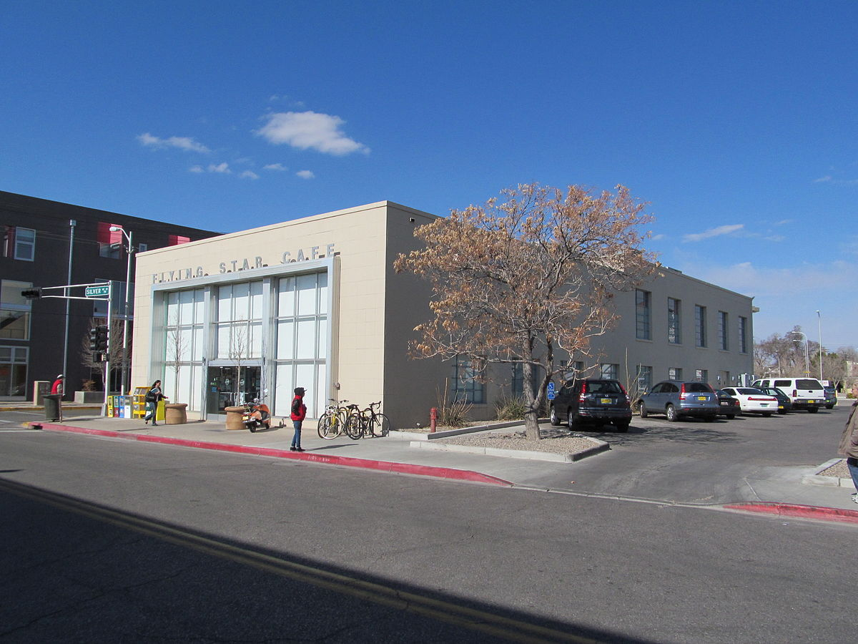
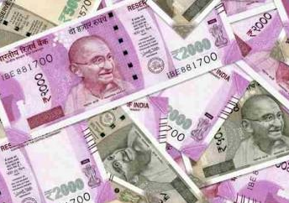
Double Entry System
Purchase of goods worth ₹500
If your payment is partly on cash (₹300) and partly on credit,(₹200) three accounts will be affected:
Purchase: ₹500
Cash: ₹300
Accounts payable: ₹200
Cash of
₹300
Accounts Payables ₹200
Your company

Slide 15
The debit – credit rule
The debit – credit rule is that asset account is debited when value increases; opposite is for liabilities.
Income account is credited when value increases; opposite is for expenses.
Purchase: ₹500 (Expense type account) Purchase ledger debited
Cash: ₹300 (Asset type account) Cash ledger credited
Accounts payable: ₹200 (Liability type account) Accounts payable ledger credited

Slide 16
The English words credit and debit come from the Latin words credre and debere, respectively. Credre means “to entrust,” and debere means “to owe”.
In financial accounting or bookkeeping, “Dr” (Debit) indicates the left side of a ledger account and “Cr” (Credit) indicates the right.
The rule that total debits equal total credits applies when all accounts are totaled.
An increase (+) to an asset account is a debit. An increase (+) to a liability account is a credit.
Conversely, a decrease (-) to an asset account is a credit. A decrease (-) to a liability account is a debit.
It is important for us to consider perspective when attempting to understand the concepts of debits and credits.

Slide 17
Three Major Financial Statements
Balance Sheet
Profit & Loss or Income statement
Cash Flow statement
A fourth statement is also used
Statement of changes in owners' equity or stockholders' equity.

Slide 18
Balance sheet
Balance sheet is a snapshot of financial position at a particular point in time.
It aims to convey the position of the assets, liabilities and owner’s equity at any particular point in time.

Slide 19
Profit & Loss or Income Statement
Profit & Loss Statement, also known as ‘Income Statement’ shows the operational performance of an enterprise for a certain period of time (contrary to balance sheet which refers to the status at a point in time).
Balance sheet as on 31.03.2021
Profit & Loss account for the year starting from 01.04.2020 to 31.03.2021

Slide 20
Cash Flow Statement
A cash flow statement is the financial statement that provides information on cash sources and uses from i. Operational activities, ii. Investment activities & iii. Financing activities, is the net cash flow of an enterprise for a specific period.
Cash flow statement contains all the receipts and payments of cash and cash equivalent of an enterprise and the net cash receipt during an accounting period. It reveals whether net cash flow is increasing or decreasing.
The net cash flow data is very useful in understanding liquidity position of a company and help eliminate any possible misperception stemming from profit data.

Slide 21
Cash flows from i. Operational activities, ii. Investment activities & iii. Financing activities
Investment activities
Operating activities
Financing activities
Net Cash Flow

Slide 22
Use of Cash Flow Statement for Startups
Money gets used up in assets, dividend, investment, and accounts receivables, some of which becomes sticky and illiquid.
Cash flow shows how liquid the business is and projected cash flow reveals if the company is likely to fall short of cash to make essential payments in the future.
If cash shortage is imminent, the founders can take preemptive action to arrange fund.

Slide 23
The fundamental and critical question to answer is how much money it will take to get the venture started.
Let us take a very simplistic example. Let’s start from setting up a new firm: a retail store.
Financial statements for any company engaged in retail business are simpler compared to those of a manufacturing company. So, let us start with a retail store.
Let us start something with which you all may connect very easily. Suppose you are starting a stationery shop at your hostel.

Slide 24
Let us see what all you need to start the business and estimate the requirement of fund:
Counter : ₹ 500
Rack : ₹ 600
Chair : ₹ 400
Subtotal ₹ 1,500
Purchase materials i.e. stationery items (pens, notebooks, files/folders, pencils, and the like): ₹ 5,000
Suppose that you want to keep some small change (cash): ₹500
Subtotal: ₹ 5,500
Total : ₹ 7,000

Slide 25
Your Business Has Two Kinds of Assets
Long-term or Fixed assets
Short-term or Current assets
Counter : ₹ 500
Rack : ₹ 600
Chair : ₹ 400
Subtotal ₹ 1,500
pens, notebooks, files/folders, pencils, and the like): ₹ 5,000
And some cash: ₹ 500

Slide 26
Fixed Assets or Long-Term Assets
All the above are assets of your business.
Give a sharp look at the items in the first part and try to understand that these items are not for sale. You need them to facilitate your business. At some point of time you may like to replace them and sell them as used machine. But that is not part of the business.
These assets are called “Long-Term Assets” or “Fixed Assets”. They contribute to your business but they remain with you for a long time.

Slide 27
Short-Term Assets or Current Assets
Contrary to ‘Fixed Assets’ the raw-materials or the stationery items are meant for selling and they are meant to be with your business for shortest possible time so that you can convert them into revenue (sales) and make profit. These are “Short-Term Assets” or “Current Assets”.

Slide 28
Arranging the Money
How do you propose to fund purchase of these fixed and current assets?
Suppose you have ₹ 3,000 with you. So, there is a shortfall of ₹ 4,000. Suppose you could borrow the remaining amount of ₹ 4,000 from your friend Rohit. So, your budgeted project outlay is fully tied up (your project reached financial closure).
Let us now prepare the balance sheet.

Slide 30
You have now started the business on 1st of April 2020.
Soon you realise that there is good demand and that you have your own engagements. So, you decide to hire an employee, say, with monthly salary of ₹ 5,000
Now you need a billing machine to keep track of inventory and sales.

Slide 32
Following are the transactions during the year 2020-21 (from 01.04.2020 to 31.03.2021)

Slide 33
Gross profit = Sales – Cost of goods sold
Operating profit = Gross profit – Operating expenses
Profit Before Tax (PBT) = Operating profit – Interest expenses
Net profit = Profit before tax – Income tax
Retained profit = Net profit – dividend
EBITDA = Earnings (profit) before Interest, tax, depreciation & amortization.

Slide 34
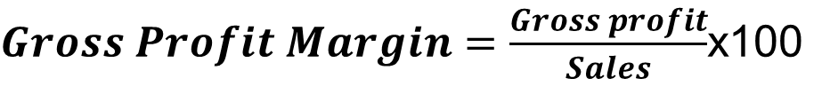

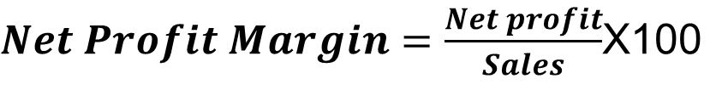
Profit Margin is percentage profit with respect to sales
$Gross Profit Margin=\frac{Gross profit}{Sales}$x100
$Operating Profit Margin=\frac{Operating profit}{Sales}$X100
$Net Profit Margin=\frac{Net profit}{Sales}$X100
$EBITDA Margin=\frac{EBITDA}{Sales}$X100
Notice that the denominator is always ‘sales’.

Slide 35
Why different types of profits??

Slide 36
Why to Estimate Different Profits
Each type of profit helps to make an apple-to-apple comparison.
Some company may be efficient in managing the process better than others. Some may be efficient in managing the operating expenses.
EBITDA helps to compare companies by eliminating the differences of depreciation, interest and tax.
Some company’s capital structure may have a high debt. So, even if they are more efficient in managing process and operation, may perform poorly on the PBT.
You want to know the cause of certain performance.

Slide 37
 | All figures are in Rupees billion
 | 19-20 | 18-19 | 19-20 | 18-19 | 19-20 | 18-19
 | Mahindra & Mahindra |  | Tata Motors |  | Maruti Suzuki
Net Sales | 951 | 1047 | 2610 | 3019 | 756 | 860
Operating Profit | 136 | 162 | 209 | 276 | 106 | 135
Operating profit margin % | 14.30 | 15.47 | 8.01 | 9.14 | 14.02 | 15.70
Interest | 60.65 | 50.21 | 72 | 57 | 1 | 0.1
Interest % to OP | 44.60 | 30.99 | 34.45 | 20.65 | 0.94 | 0.07
PBDT | 75 | 112 | 137 | 218 | 105 | 134
Profit Before Tax | 6 | 75 | -105 | -313 | 69 | 104
Provision for Tax | 19 | 28 | 3 | -24 | 14 | 29
Profit After Tax | -13 | 46 | -109 | -289 | 55 | 74
Net profit margin | -0.01 | 0.04 | -0.04 | -0.10 | 0.07 | 0.09
Share price ₹ | 615 |  | 148 |  | 7128

Slide 38
Why to Estimate Different Profits
Gross profit reflects efficiency of converting inputs into sales. If one company’s gross profit margin (percentage) is more than others in the same industry, it is because one or more of the followings:
More efficiently converts raw-materials into finished goods.
More energy-efficient process.
Sells at higher price than competitors.
Bargaining power in buying inputs.
Use more efficient manufacturing process than others.
In short, they are more efficient and likely to be more profitable than competitors

Slide 39
# Operating Profit Margin is Combination of Processing and Operational efficiency. # However, it does not take into account the differentiation caused due to cost of financing across companies. # PBT margin takes into account the finance costs. # Net profit margin takes into account the income tax management.

Slide 40
You prepare balance sheet at this point of time, i.e. as on a particular date: here, as on 31.03.2020
You prepare balance sheet at this point of time, i.e. as on a particular date: here, as on 31.03.2021
You prepare Profit & Loss Account for this entire period, i.e. from 01st April 2020 to 31st March 2021
Year 2020-21
Year 2019-20
PURCHASE DURING THE YEAR
Year 2021-22
You purchase a lot of stocks and sell a lot of them during the year. But some stocks remain unsold, they are the closing stock
Closing stock
Opening stock
Closing stock
Opening stock
Closing stock: ₹5,000
Opening stock: ₹5,000
Closing stock: ₹10,000
Opening stock: ₹10,000
Year 2019-20
Year 2020-21
Year 2020-21
Year 2021-22
Closing stock is the stock or inventory that remains unsold as at the close of business of any particular year. You begin the business in the next year with the closing stock of the previous year. Therefore, the closing stock of the previous year becomes the opening stock of the next year.

Slide 41
Opening stock data is obtained from previous year balance sheet. It is the closing stock of previous year.
Cost of goods sold = Opening inventory + Purchase during the year – Closing Inventory

Slide 42
Opening stock data is obtained from previous year balance sheet. It is the closing stock of previous year.

Slide 43
For the purpose of estimating ‘Materials consumed’ to derive ‘Gross Profit’ previous year’s ‘Closing stock’ is current year’s ‘Opening stock’.

Slide 44
Opening stock data is obtained from previous year balance sheet. It is the closing stock of previous year.
(+)
( ̶ )

Slide 45
Depreciation
Depreciation is an accounting method of gradual apportioning of the cost incurred to acquire a tangible asset as expense over its useful life.
Businesses depreciate long-term assets differently for two different accounting purposes: i. for tax and ii. for reporting to stakeholders.

Slide 46
Depreciation is the process of charging the loss of value of capital assets in Profit & Loss A/C
Through depreciation, the procurement costs of capital assets are gradually charged in the profit & loss account.
The other alternative is to charge the entire cost of acquisition as expense in the year the expenditure is incurred.
But that would cause great volatility in the bottom-line (profit), which is not desirable.

Slide 47
Depreciation is gradual apportioning of the cost of a tangible asset over its useful life span. Businesses depreciate long-term assets mostly differently for accounting and tax purposes.
Detailed discussion on methods of depreciation and their significance would be made later

Slide 48
Following are the transactions during the year 2020-21 (from 01.04.2020 to 31.03.2021)

Slide 49
Let us estimate the operating expenses for the year 2020-21 (i.e. the year starting on 01.04.2020 and ending on 31.03.2021)

Slide 50
Note that the profit of proprietorship firm is clubbed with personal income of the proprietor. All income tax benefits of personal income is available.
We have considered 30% only for demonstration. The Current rate is about 22%

Slide 51
Continued from the previous slide

Slide 52
Assets portion of the balance sheet

Slide 53
Liabilities portion of the balance sheet
₹
Loan from your friend, Rohit

Slide 54
Complete balance sheet
As on 31.03.2018
The total assets and the total liabilities must be the same

Slide 55
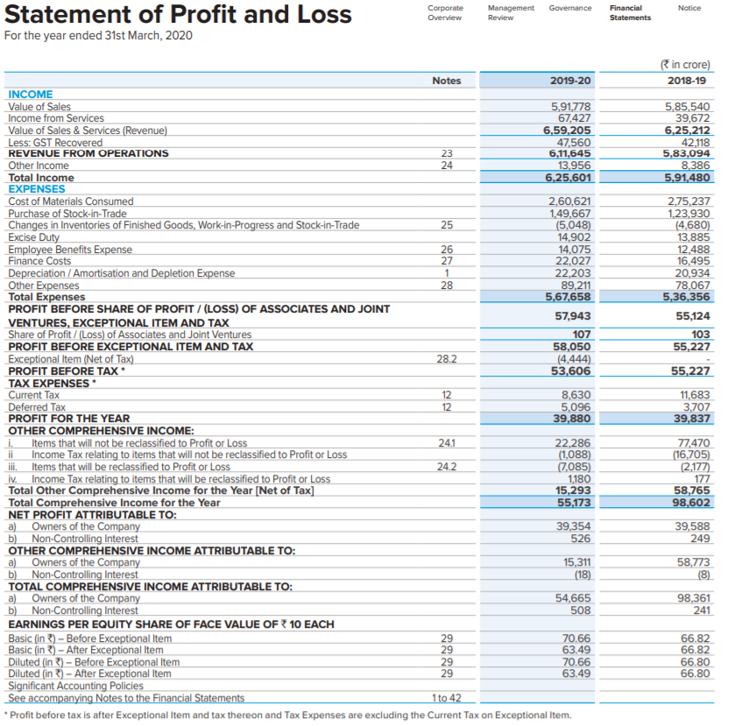
Reliance Industries Ltd

Slide 56
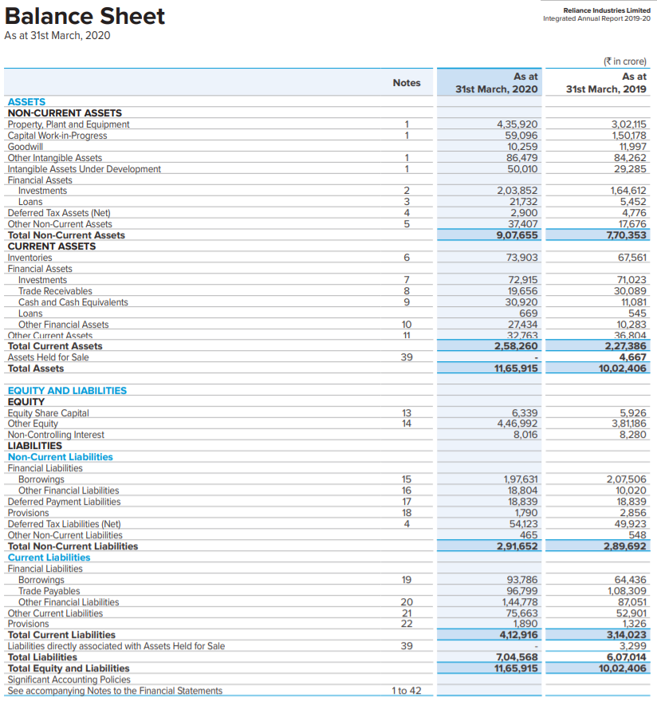
Reliance Industries Ltd

Slide 57
Cash Flow Statement
Cash flow statement is a summary of a company’s cash inflows and outflows during a certain period of time.
All cash flow items are grouped into three categories based on their origins: i. Operating activities, ii. Investment activities, and iii. Financing activities.
Bankers and analysts are interested in all categories in order to understand if all three heads are in good shape.
Founders are particularly interested in meeting cash requirements for all the three activities and the overall ending cash balance.

Slide 58
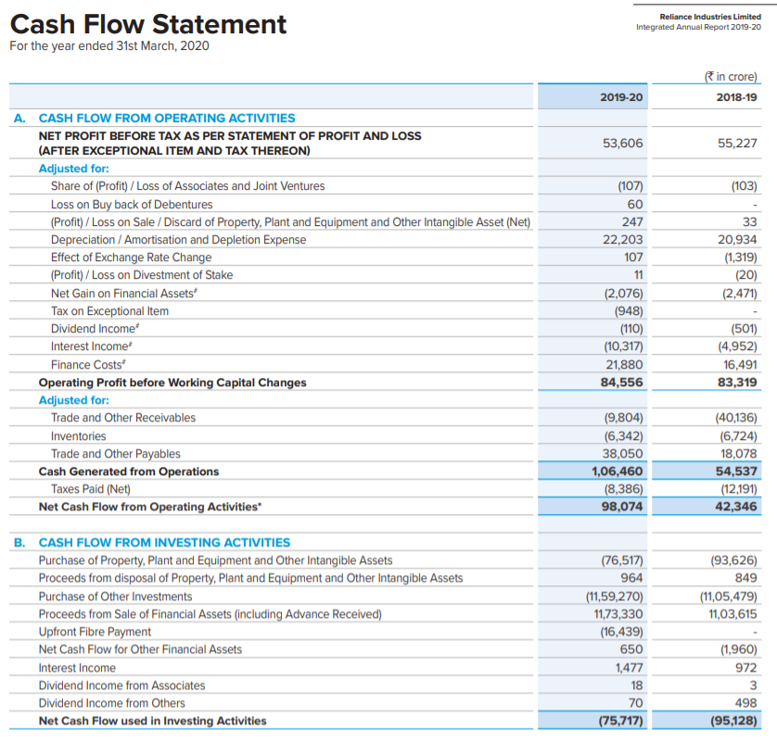
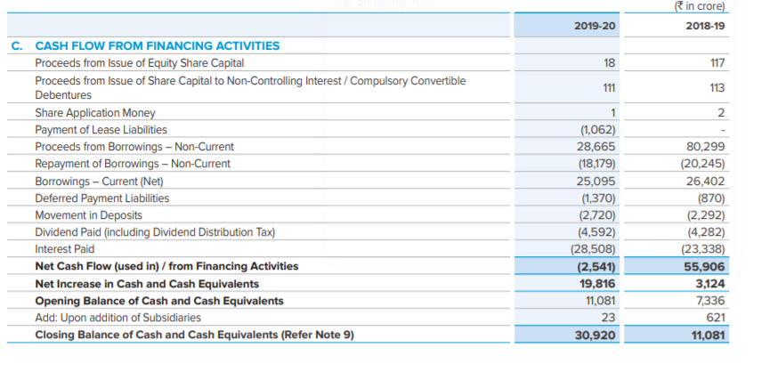
Reliance Industries Ltd

Slide 59
For additional reading please visit the site of Ministry of Corporate Affair at http://www.mca.gov.in/Ministry/notification/pdf/AS_3.pdf
Cash equivalents are short term, highly liquid investments that are readily convertible into known amounts of cash and which are subject to an insignificant risk of changes in value.
For an investment to qualify as a cash equivalent, it must be readily convertible to a known amount of cash and be subject to an insignificant risk of changes in value. Therefore, an investment normally qualifies as a cash equivalent only when it has a short maturity of, say, three months or less from the date of acquisition.

Slide 60
Indirect Method: Cash Flow from Operational Activities
Total cash flow from operating activities =
+ Net profit (known as Net Income in USA)
+ Depreciation (This was deducted as expense. But no cash went out)
+ Losses from sale of fixed assets, if any.
— Gains from sale of fixed assets, if any.
(Note that sales value of fixed assets will be included in in cash flow from investment activity)
— Increase in current assets.
+ Decrease in current assets.
+ Increase in current liabilities
— Decrease in current liabilities

Slide 61
Cash Flow from Investment Activities
+ Capital expenditure
+ Investment

Slide 62
Cash Flow from Financing Activities
+ Net borrowing.
— Net investment in equity or debt.
— Dividend paid
+ Fresh equity induction.

Slide 63
= A + B – C + D
You have repaid ₹2,000 to Jack out of his loan of ₹ 4,000 during the year
= E – F – H
= K + L

Slide 64
Estimate Net Profit
Adjust for non-cash gains (add) and losses (subtract)
Estimate net cash inflow and outflow out of changes in current assets and liabilities
Add/subtract the above three to get cash flow from operating activities
Cash flow from Investment activities:
Changes in fixed assets/ investment
Cash flow from financing activities: Changes in long-term liabilities and equity
Add up cash inflows/subtract outflows from three activities
Add the closing cash balance of the previous year (with signs)
Cash balance as at the end of the year

Slide 65
References:
https://www.caclubindia.comText 1
http://www.mca.gov.in/MinistryV2/accountingstandards1.html
Horngren, C. T., Sundem, G. L., Elliott, J. A., & Philbrick, D. R. (2002). Introduction to financial accounting (Vol. 8). Prentice Hall.

Slide 66
Understanding financial statements is easy.
Having an understanding of the financial statements is essential for everybody, no matter which profession one is in.

Slide 67
Determination Is The Biggest Predictor Of Long-term Success

Slide 68
Thank you

